Slide 1
GSD R14 Volume
RPL- Request : 43160

Slide 2
Version History
Version | Date | Updated By | Description
V0.1 | April 6, 2018 | Rasool | Initial Version Created

Slide 3
Build CRP
BR-43160
Req ID | Req Description
43160 | RPL – force user to select a valid Reason for RPL Override (make field mandatory)
Build Strategy
When Reason for RPL Override is selected as “–None-” value then override is prevented .
An alert message will pop up showing “None is not a complaint reason for RPL Override – Select appropriate reason”.
Created new field:
GSD_CSC_RPL_Override_Reason_Alert

Slide 4
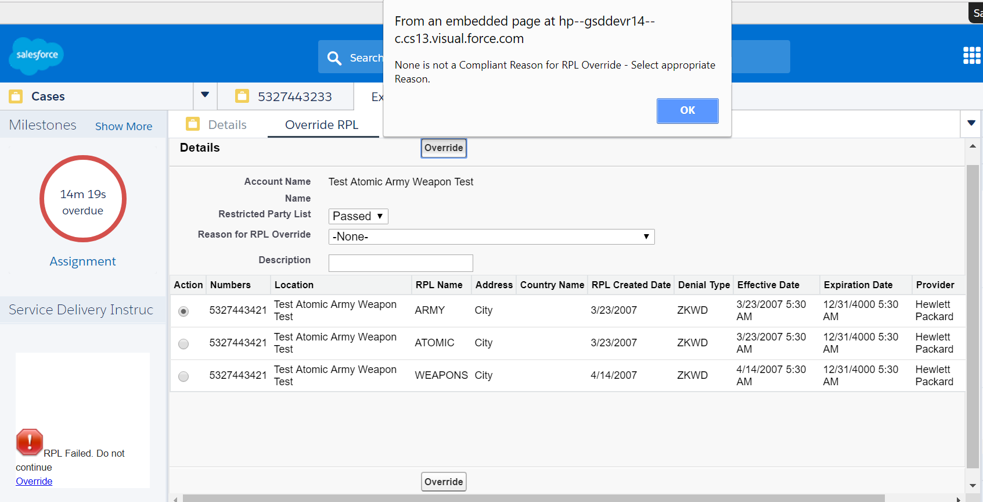
Build CRP
BR-43160

Slide 5
Build CRP
BR-43160
Req ID | Req Description
43160 | RPL – force user to select a valid Reason for RPL Override (make field mandatory)
Components:
Component Name | Component Type
GSDCSCRPLLogPage | Visualforce Page
GSD_CSC_RPL_Override_Reason_Alert | Custom Label

Slide 6
Thank you

